Slide 1
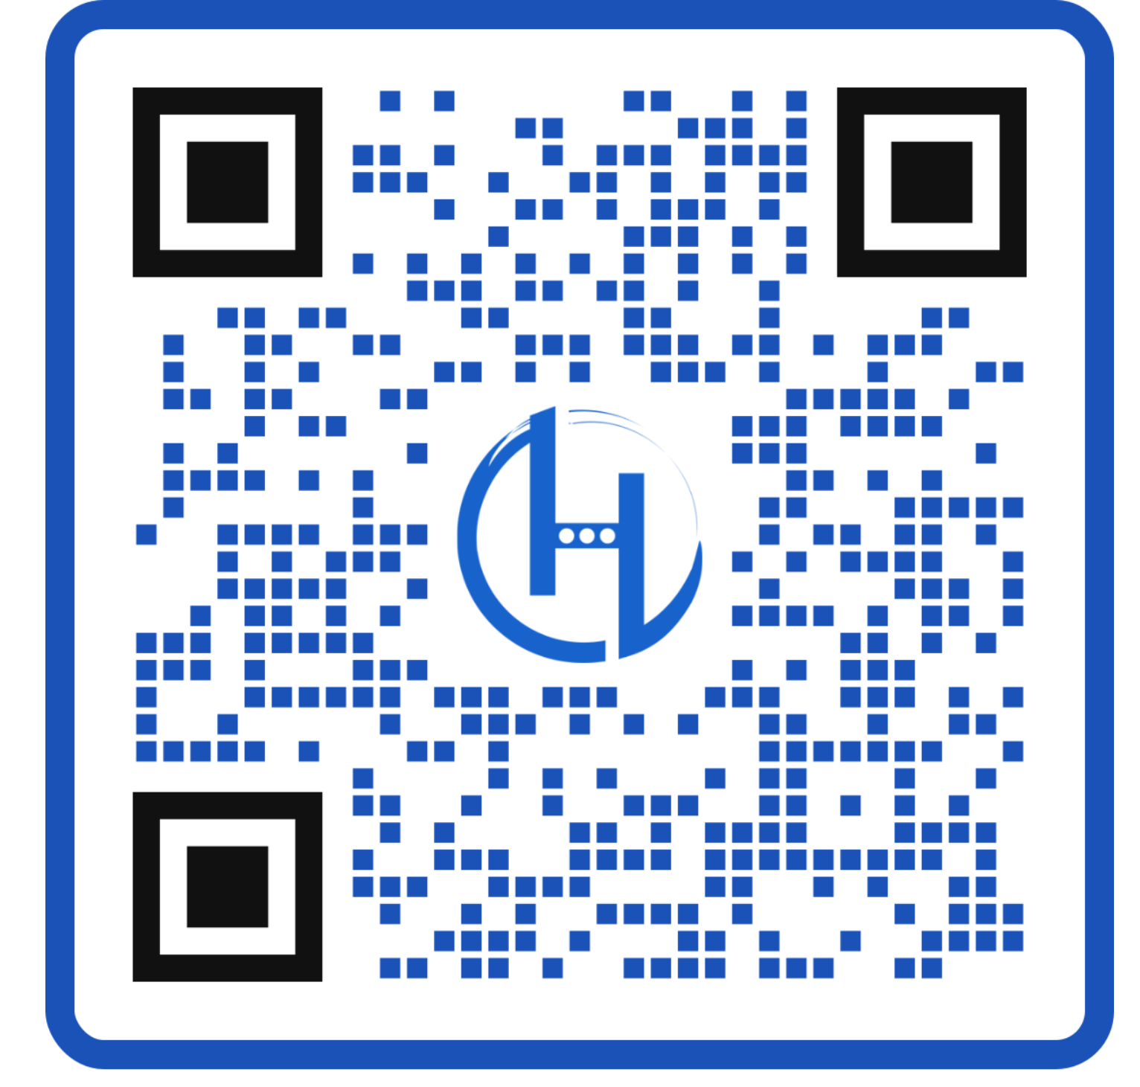
KEVIN BROWN
@KevinBrownSpeaks
@KBHeroSpeaker
@HeroSpeaker
Scan for exclusive updates, learn more about Kevin's book, and more!

