Slide 1
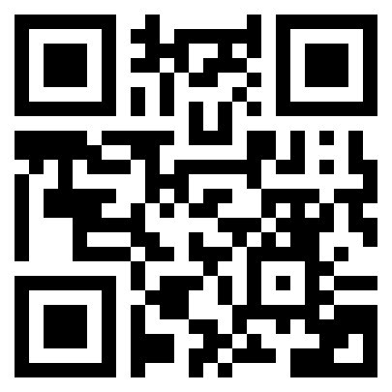
KEVIN BROWN
@KevinBrownSpeaks
@KBHeroSpeaker
@HeroSpeaker
Scan the QR Code to receive updates from Kevin

Slide 2
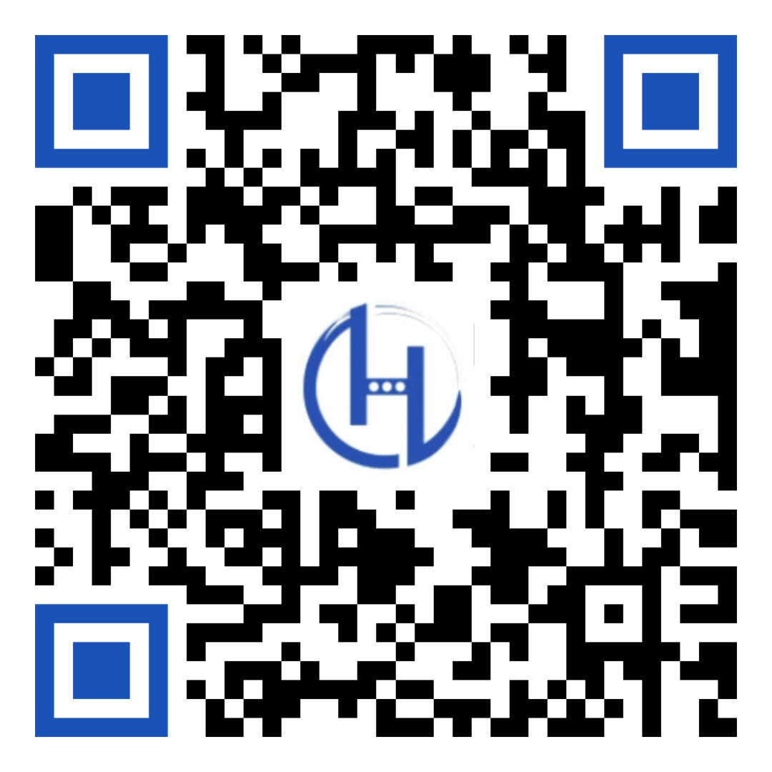
KEVIN BROWN
@KevinBrownSpeaks
@KBHeroSpeaker
@HeroSpeaker
Learn more about Kevin's Book

