Slide 1


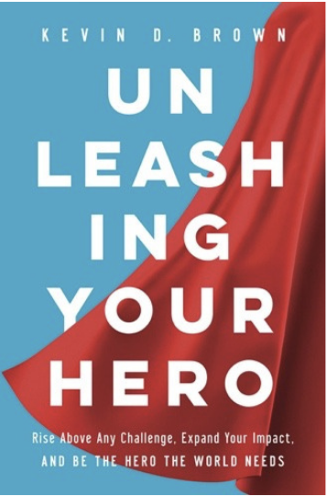





H
Heroes HELP people…with no strings attached
E
Heroes create an EXCEPTIONAL experience for the people they serve
R
Heroes take RESPONSIBILITY for their attitude, actions and results
O
Heroes see life through the lens of OPTIMISM
Don’t Settle for Ordinary…
In Unleashing Your Hero, renowned speaker Kevin Brown shares how the heroes who transformed his life are people just like you. People who stepped up and used their talents to make a positive difference within the hectic moments of everyday life. This book will help you recognize the extraordinary gifts within you and learn how to share those gifts to make life better for yourself and those you influence.
@kevinbrownspeaks
@herospeaker
@KBHeroSpeaker
@HeroSpeaker

